Slide 1
Secure Routing
03
Kai Bu
kaibu@zju.edu.cn
http://list.zju.edu.cn/kaibu/netsec2022
Notes:
In previous lectures, we use https to showcase how two communication entities (e.g., a client and a server) exchange messages to build a secure connection over public internet.
However, how can a network know how to deliver packets such that they can reach the correct destination?
More specifically, how can a network decide which route a packet should follow?
This touches exactly one of the fundamental building blocks of traffic management, which is

Slide 2
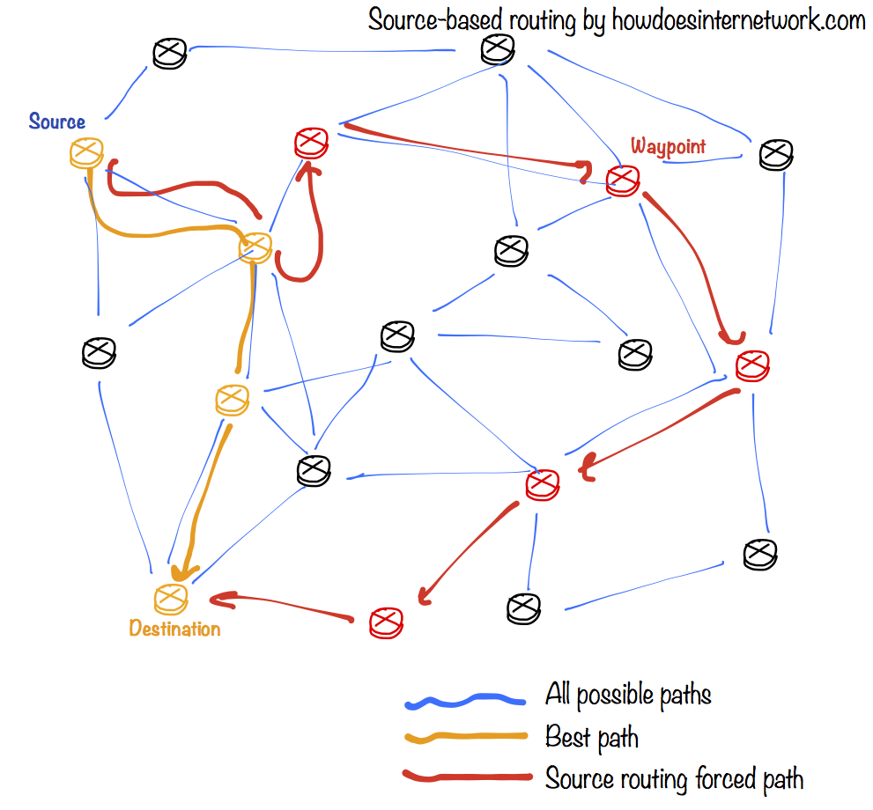
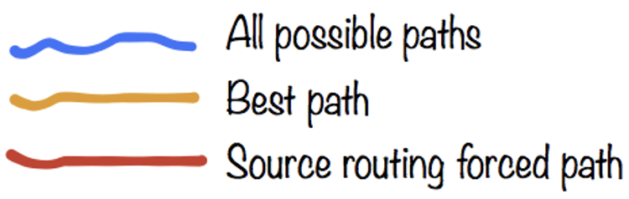
Secure Routing
select a path for traffic
in a network
Notes:
Routing
By definition, routing is the process of selecting a path for traffic in a network, or between or across multiple networks.

Slide 3
Secure Routing
How does routing work?
How is routing attacked?
How is routing secured?
Notes:
Discussions to be covered include routing’s working principles, vulnerabilities, and security solutions.

Slide 4




Delivery Scheme
unicast
deliver msg to a single node
broadcast
deliver msg to all nodes in network
multicast
deliver msg to a group of nodes
anycast
deliver msg to any one of a group
Notes:
Routing schemes differ in how they deliver messages:
unicast delivers a message to a single specific node
broadcast delivers a message to all nodes in the network
multicast delivers a message to a group of nodes that have expressed interest in receiving the message
anycast delivers a message to any one out of a group of nodes, typically the one nearest to the source
geocast delivers a message to a group of nodes based on geographic location
Unicast is the dominant form of message delivery on the Internet.

Slide 5

Delivery Scheme
unicast
deliver msg to a single node
broadcast
deliver msg to all nodes in network
geocast
deliver a message to a group of nodes
based on geographic location
multicast
deliver msg to a group of nodes
anycast
deliver msg to any one of a group
Notes:
geocast delivers a message to a group of nodes based on geographic location

Slide 6
Delivery Scheme
unicast
deliver msg to a single node
dominant form of msg delivery on inet
Notes:
Unicast is the dominant form of message delivery on the Internet.
Build most of our discussions on it

Slide 7
Routing Scheme
unicast
deliver msg to a single node
how to find a feasible path?
Notes:
Now given the goal of delivering a message from one node to another, how to find a feasible path between them?
This is the focus of a routing scheme.

Slide 8
Routing Scheme
Intra-domain routing
inside an autonomous system
Inter-domain routing
between autonomous systems
Notes:
Depending on whether the two communication entities are in the same autonomous system,
There are two different routing schemes.
One is intra-domain routing, it targets path finding inside an autonomous system
The other is inter-domain routing, apparently, it aims to find paths between nodes from different autonomous systems.

Slide 9
Routing Scheme
Intra-domain routing
consider A-F as routers
Inter-domain routing
consider A-F as autonomous systems
5
B
3
C
2
5
A
2
1
F
examples from
https://www.cs.umd.edu/~shankar/417-F01/Slides/chapter4a-aus/
https://www.cs.umd.edu/~shankar/417-F01/Slides/chapter4b-aus/
3
1
2
D
E
1

Slide 10
Route Computation
Link-state algorithms
each router knows complete topology & link cost information;
independently run routing algorithm to calculate shortest path to each destination;
5
B
3
C
2
5
A
2
1
F
3
1
2
D
E
1
Notes:
route computation algorithms
link-state (Dijkstra)
each router knows complete topology & link cost information
Run routing algorithm to calculate shortest path to each destination
distance-vector (Bellman-Ford)
Each router knows direct neighbors & link costs to neighbors
Calculate the shortest path to each destination through an iterative process based on the neighbors distances to each destination

Slide 11
Dijkstra
c(i,j) link cost from i to j (∞ if unknown)
D(v) current value of cost of path from
source to destination v;
p(v) predecessor node along path from
source to v;
N’ set of nodes whose least
cost path is already known;
5
B
3
C
2
5
A
2
1
F
3
1
2
D
E
1
Notes:
c(i,j): link cost from node i to j (∞ if not known)
D(v): current value of cost of path from source to dest. V
p(v): predecessor node along path from source to v, (neighbor of v)
N': set of nodes whose least cost path already known

Slide 12
Dijkstra
1 Initialization:
2 N' = {A}
3 for all nodes v
4 if v adjacent to A
5 then D(v) = c(A,v)
6 else D(v) = ∞
7
8 Loop
find w not in N' such that D(w) is
minimum
10 add w to N'
11 update D(v) for all v adjacent to w and not in N':
12 D(v) = min(D(v), D(w) + c(w,v))
13 /* new cost to v is either the old cost, or known shortest path cost to w plus cost from w to v */
14 until all nodes in N'
5
B
3
C
2
5
A
2
1
F
3
1
2
D
E
1
Notes:
example

Slide 13
Dijkstra
Step
0
1
2
3
4
5
start N'
A
AD
ADE
ADEB
ADEBC
ADEBCF
D(B),p(B)
2,A
2,A
2,A
D(C),p(C)
5,A
4,D
3,E
3,E
D(D),p(D)
1,A
D(E),p(E)
infinity
2,D
D(F),p(F)
infinity
infinity
4,E
4,E
4,E
5
B
3
C
2
5
A
2
1
F
3
1
2
D
E
1
Notes:
example

Slide 14
Dijkstra
Step
0
1
2
3
4
5
start N'
A
AD
ADE
ADEB
ADEBC
ADEBCF
D(B),p(B)
2,A
2,A
2,A
D(C),p(C)
5,A
4,D
3,E
3,E
D(D),p(D)
1,A
D(E),p(E)
infinity
2,D
D(F),p(F)
infinity
infinity
4,E
4,E
4,E
resulting shortest-path tree for A:
5
5
3
B
3
C
B
C
5
2
5
2
A
A
2
2
F
1
F
3
1
3
1
1
2
D
2
D
E
E
1
1
Notes:
example

Slide 15
Dijkstra
Step
0
1
2
3
4
5
start N'
A
AD
ADE
ADEB
ADEBC
ADEBCF
D(B),p(B)
2,A
2,A
2,A
D(C),p(C)
5,A
4,D
3,E
3,E
D(D),p(D)
1,A
D(E),p(E)
infinity
2,D
D(F),p(F)
infinity
infinity
4,E
4,E
4,E
resulting shortest-path tree for A:
destination
link
5
5
B
(A, B)
3
D
(A, D)
B
3
C
B
C
5
2
5
2
E
(A, D)
A
A
2
2
F
1
F
3
1
C
(A, D)
3
1
1
2
D
2
D
E
F
(A, D)
E
1
1
Notes:
example

Slide 16
what if no global view?
Notes:
Such link-state algorithms require that each router knows complete topology & link cost information;
What if a router has no such global view, especially in a relatively large network?

Slide 17
Route Computation
Distance-vector algorithms
each router knows direct neighbors & link costs to neighbors;
independently calculate shortest path to each destination through an iterative process based on neighbors’ distances to dest;
5
B
3
C
2
5
A
2
1
F
3
1
2
D
E
1
Notes:
In this case, we can turn to distance-vector algorithms;
distance-vector (Bellman-Ford)
Each router knows direct neighbors & link costs to neighbors
Calculate the shortest path to each destination through an iterative process based on the neighbors distances to each destination

Slide 18
Bellman-Ford
D_{x}(y) cost of least-cost path from x to y:
D_{x}(y) = min{c(x,v) + D_{v}(y)} for all neighbors v of x
5
B
3
C
2
5
A
2
1
F
3
1
2
D
E
1
Notes:
a typical distance-vector algorithm is Bellman-Ford
Define: D_{x}(y) := cost of least-cost path from x to y
Then D_{x}(y) = min {c(x,v) + D_{v}(y) }
where min is taken over all neighbors v of x

Slide 19
Bellman-Ford
D_{x}(y) cost of least-cost path from x to y:
wait for (change in local link cost of msg from neighbor)
recompute estimates
if DV to any dest has changed, notify neighbors
5
B
3
C
2
5
A
2
1
F
3
1
2
D
E
1
Notes:
Define: D_{x}(y) := cost of least-cost path from x to y
Then D_{x}(y) = min {c(x,v) + D_{v}(y) }
where min is taken over all neighbors v of x

Slide 20
Bellman-Ford
D_{x}(y) cost of least-cost path from x to y:
D_{x}(y) = min{c(x,v) + D_{v}(y)} for all neighbors v of x
D_{A}(F) = min {c(A,B) + D_{B}(F),
c(A,D) + D_{D}(F),
c(A,C) + D_{C}(F) }
= min {2 + 5,
1 + 3,
5 + 3} = 4
5
B
3
C
2
5
A
2
1
F
3
node leading to shortest path is next hop → forwarding table
1
2
D
E
1
Notes:
Define: D_{x}(y) := cost of least-cost path from x to y
Then D_{x}(y) = min {c(x,v) + D_{v}(y) }
where min is taken over all neighbors v of x

Slide 21
intra-domain vs inter-domain
Notes:
As we mentioned, both types of path computation algorithms can be used for intra-domain routing and inter-domain routing

Slide 22
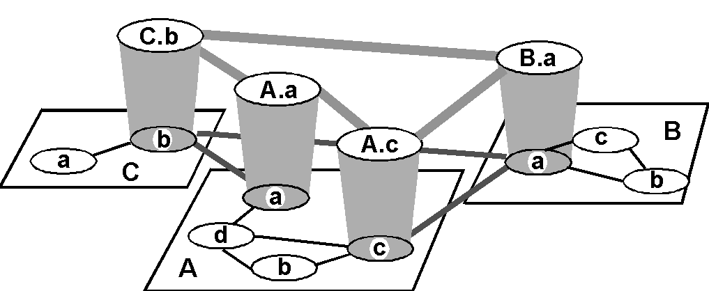
Hierarchical Routing
inter-AS border (exterior gateway) routers
intra-AS (interior gateway) routers

Slide 23
Hierarchical Routing
inter-AS border (exterior gateway) routers
intra-AS (interior gateway) routers
AS: autonomous system
each AS uses its own IGP internal routing protocol;
border routers run BGP as well;

Slide 24
IGP: Interior Gateway Prot
RIP
routing information protocol
OSPF
open shortest path first
Notes:
IGP: interior gateway protocols

Slide 25
RIP
Distance-vector algorithm
distance metric: # of hops (max=15)
Neighbor routers exchange routing advertisement every 30 seconds
Failure and recovery
if no update from neighbor N after 180s invalidate routes via N, notify neighbors
Notes:
Distance vector algorithm
Distance metric: # of hops (max = 15 hops)
Neighbor routers exchanged routing advertisement every 30 seconds
Failure and Recovery: If no update from neighbor N heard after 180 sec  neighbor/link declared dead
All routes via N invalidated; updates sent to neighbors
neighbors in turn may send out new advertisements (if tables changed)
Use poison reverse to prevent ping-pong loops (16 hops = ∞)

Slide 26
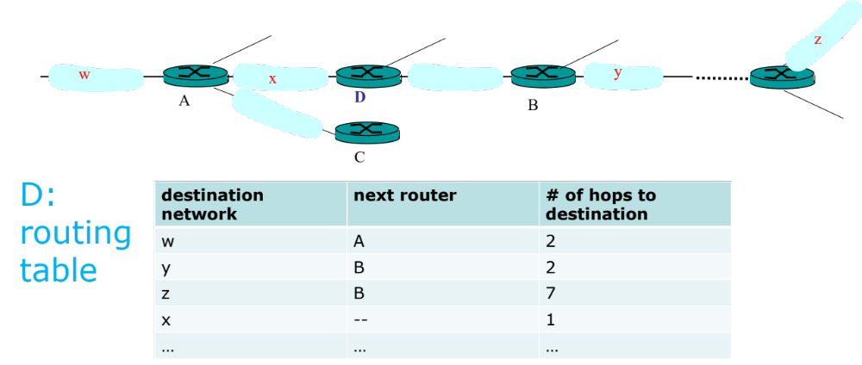
RIP

Slide 27
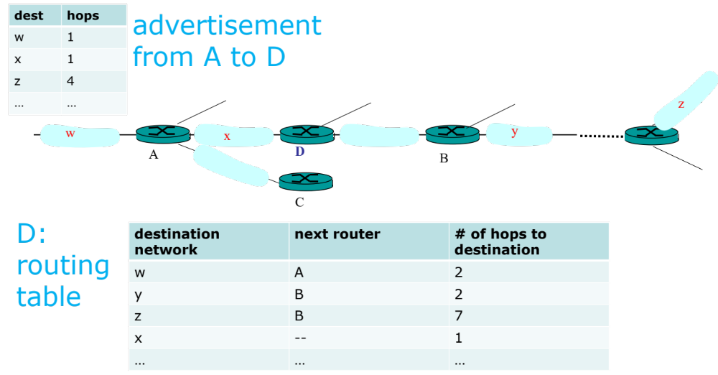
RIP

Slide 28

RIP

Slide 29
OSPF
Link-state algorithm
each node knows its direct neighbors & the link distance to each(link-state);
each node periodically broadcasts its link-state to the entire network;
Notes:
A Link State protocol
each node knows its directly connected neighbors & the link distance to each (link-state)
each node periodically broadcasts its link-state to the entire network

Slide 30
OSPF
LSP (Link-State Packet)
one entry per neighbor router:
ID of the node that created the LSP;
a list of direct neighbors, with link cost;
sequence number for this LSP (SEQ);
time-to-live (TTL) for info in this LSP;
Notes:
Link-State Packet: one entry per neighbor router
ID of the node that created the LSP
a list of direct neighbors, with link cost to each
sequence number for this LSP message (SEQ)
time-to-live (TTL) for information carried in this LSP
Use raw IP packet (protocol ID = 89)

Slide 31
OSPF
Build a complete map using link states
everyone broadcasts a piece of topology;
put all pieces together → complete map
Notes:
Link-State Packet: one entry per neighbor router
ID of the node that created the LSP
a list of direct neighbors, with link cost to each
sequence number for this LSP message (SEQ)
time-to-live (TTL) for information carried in this LSP
Use raw IP packet (protocol ID = 89)

Slide 32
OSPF
Each node stores and forwards LSPs
Decrement TTL of stored SLPs
Discard info when TTL=0
Compute routes using Dijkstra
Generate LSPs periodically with increasing SEQ
Notes:
The routing daemon running at each node: Builds and maintains topology map at each node
Stores and forwards most recent LSP from all other nodes
decrement TTL of stored LSP; discard info when TTL=0
Compute routes using Dijkstra’s algorithm
generates its own LSP periodically with increasing SEQ

Slide 33
OSPF
Reliable flooding of LSP
forward each received LSP to all neighbors but the one that sent it;
use the source-ID and SEQ to detect duplicates;
X
A
C
B
D
X
A
X
A
X
A
C
B
D
C
B
D
C
B
D
Notes:
forward each received LSP to all neighbor nodes but the one that sent it
each ISP is reliably delivered over each link
use the source-ID and SEQ in a LSP to detect duplicates
LSPs sent both periodically and event-driven

Slide 34
OSPF
All OSPF messages are authenticated
Multiple same-cost paths are allowed
Hierarchical OSPF is used in large dom
Notes:
Security: all OSPF messages authenticated
Multiple same-cost paths allowed
For each link, multiple cost metrics for different TOS (eg, satellite link cost set “low” for best effort; high for real time)
Integrated uni- and multicast support:
Multicast OSPF (MOSPF) uses same topology data base as OSPF
Hierarchical OSPF in large domains.

Slide 35

Hierarchical OSPF
Link-state ads only in area
each node has detailed
area topology,
but only direction (shortest
path) to other areas;
Notes:
Two-level hierarchy: local area, backbone.
Link-state advertisements only in area
each nodes has detailed area topology; only know direction (shortest path) to nets in other areas.
Area border routers: “summarize” distances to nets in own area, advertise to other Area Border routers.
Backbone routers: run OSPF routing limited to backbone.
Boundary routers: connect to other AS’s.

Slide 36
Hierarchical OSPF
summarize distances
to routers in local area;
advertise to
other area border routers;
Notes:
Two-level hierarchy: local area, backbone.
Link-state advertisements only in area
each nodes has detailed area topology; only know direction (shortest path) to nets in other areas.
Area border routers: “summarize” distances to nets in own area, advertise to other Area Border routers.
Backbone routers: run OSPF routing limited to backbone.
Boundary routers: connect to other AS’s.

Slide 37
Hierarchical OSPF
run OSPF routing
limited to backbone
Notes:
Two-level hierarchy: local area, backbone.
Link-state advertisements only in area
each nodes has detailed area topology; only know direction (shortest path) to nets in other areas.
Area border routers: “summarize” distances to nets in own area, advertise to other Area Border routers.
Backbone routers: run OSPF routing limited to backbone.
Boundary routers: connect to other AS’s.

Slide 38
Hierarchical OSPF
connect to
other ASes
Notes:
Two-level hierarchy: local area, backbone.
Link-state advertisements only in area
each nodes has detailed area topology; only know direction (shortest path) to nets in other areas.
Area border routers: “summarize” distances to nets in own area, advertise to other Area Border routers.
Backbone routers: run OSPF routing limited to backbone.
Boundary routers: connect to other AS’s.

Slide 39
inter-domain routing
BGP: Border Gateway Protocol
Notes:
Connect other Ases
inter-domain routing required;

Slide 40
BGP
Path-vector protocol among border routers
each border router broadcasts to neighbors entire path of AS sequence to destination:
e.g., Path(B,C) = B, A, C
Notes:
BGP (Border Gateway Protocol): the de facto standard
Path Vector protocol:
similar to Distance Vector protocol
each Border router broadcast to neighbors (peers) entire path (I.e, sequence of ASs) to destination
E.g., Path (X,Z) = X,Y1,Y2,Y3,…,Z

Slide 41
BGP
For each AS:
Obtain subnet reachability information from neighbor ASes;
Propagate the reachability information to all internal routers;
Determine routes to subnets based on reachability information and policy
Notes:
BGP (Border Gateway Protocol): the de facto standard
BGP provides each AS a means to:
Obtain subnet reachability information from neighboring ASs.
Propagate the reachability information to all routers internal to the AS.
Determine “good” routes to subnets based on reachability information and policy.
Allows a subnet to advertise its existence to rest of the Internet: “I am here”

Slide 42
BGP
x
Example: forwarding table entry for d→x
Notes:
Suppose AS A learns from the inter-AS protocol that subnet x is reachable from AS B (gateway A.c) but not from AS C.
Inter-AS protocol propagates reachability info to all internal routers.
Router d determines from intra-AS routing info that its interface I is on the least cost path to c.
Puts in forwarding table entry (x, I).

Slide 43
BGP
x
x
Example: forwarding table entry for d→x
AS A learns from BGP that subnet x is reachable from AS B via border router A.c;
Notes:
Suppose AS A learns from the inter-AS protocol that subnet x is reachable from AS B (gateway A.c) but not from AS C.
Inter-AS protocol propagates reachability info to all internal routers.
Router d determines from intra-AS routing info that its interface I is on the least cost path to c.
Puts in forwarding table entry (x, I).

Slide 44
BGP
x
x
x
Example: forwarding table entry for d→x
router d determines from intra-domain routing info that its interface I is on the least cost path to c;
Notes:
Suppose AS A learns from the inter-AS protocol that subnet x is reachable from AS B (gateway A.c) but not from AS C.
Inter-AS protocol propagates reachability info to all internal routers.
Router d determines from intra-AS routing info that its interface I is on the least cost path to c.
Puts in forwarding table entry (x, I).

Slide 45
BGP
x
x
x
Example: forwarding table entry for d→x
destination | next hop
x | I
Notes:
Suppose AS A learns from the inter-AS protocol that subnet x is reachable from AS B (gateway A.c) but not from AS C.
Inter-AS protocol propagates reachability info to all internal routers.
Router d determines from intra-AS routing info that its interface I is on the least cost path to c.
Puts in forwarding table entry (x, I).

Slide 46
BGP
Distribute reachability information:
with eBGP session 3a-to-1c,
AS3 sends prefix reachability info to AS1
3c
P
3a
2c
3b
2a
AS3
2b
1c
AS2
1a
1b
AS1
1d
eBGP session
iBGP session
Notes:
internal bgp, external bgp
With eBGP session between 3a and 1c, AS3 sends prefix reachability info to AS1.
1c can then use iBGP to distribute this new prefix reach info to all routers in AS1
1b can then re-advertise the new reach info to AS2 over the 1b-to-2a eBGP session
When router learns about a new prefix, it creates an entry for the prefix in its forwarding table.

Slide 47
BGP
Distribute reachability information:
1c uses iBGP sessions to distribute
this new prefix reachability info to all routers in AS1;
3c
3c
P
P
2c
3a
2c
3a
3b
3b
2a
2a
AS3
AS3
2b
2b
1c
1c
AS2
AS2
1a
1a
1b
1b
1d
AS1
1d
AS1
eBGP session
eBGP session
iBGP session
iBGP session
Notes:
With eBGP session between 3a and 1c, AS3 sends prefix reachability info to AS1.
1c can then use iBGP to distribute this new prefix reach info to all routers in AS1
1b can then re-advertise the new reach info to AS2 over the 1b-to-2a eBGP session
When router learns about a new prefix, it creates an entry for the prefix in its forwarding table.

Slide 48
BGP
Distribute reachability information:
1b re-advertises the new reachability info to AS2
over the 1b-to-2a eBGP session;
3c
3c
3c
P
P
P
2c
2c
3a
2c
3a
3a
3b
3b
3b
2a
2a
2a
AS3
AS3
AS3
2b
2b
2b
1c
1c
1c
AS2
AS2
AS2
1a
1a
1a
1b
1b
1b
1d
1d
AS1
1d
AS1
AS1
eBGP session
eBGP session
eBGP session
iBGP session
iBGP session
iBGP session
Notes:
With eBGP session between 3a and 1c, AS3 sends prefix reachability info to AS1.
1c can then use iBGP to distribute this new prefix reach info to all routers in AS1
1b can then re-advertise the new reach info to AS2 over the 1b-to-2a eBGP session
When router learns about a new prefix, it creates an entry for the prefix in its forwarding table.

Slide 49
BGP
Distribute reachability information:
1b re-advertises the new reachability info to AS2
over the 1b-to-2a eBGP session;
when a router learns about a new prefix,
it creates a forwarding table entry for the prefix
3c
3c
3c
3c
P
P
P
P
2c
2c
2c
3a
2c
3a
3a
3a
3b
3b
3b
3b
2a
2a
2a
2a
AS3
AS3
AS3
AS3
2b
2b
2b
2b
1c
1c
1c
1c
AS2
AS2
AS2
AS2
1a
1a
1a
1a
1b
1b
1b
1b
1d
1d
1d
AS1
1d
AS1
AS1
AS1
eBGP session
eBGP session
eBGP session
eBGP session
iBGP session
iBGP session
iBGP session
iBGP session
Notes:
With eBGP session between 3a and 1c, AS3 sends prefix reachability info to AS1.
1c can then use iBGP to distribute this new prefix reach info to all routers in AS1
1b can then re-advertise the new reach info to AS2 over the 1b-to-2a eBGP session
When router learns about a new prefix, it creates an entry for the prefix in its forwarding table.

Slide 50
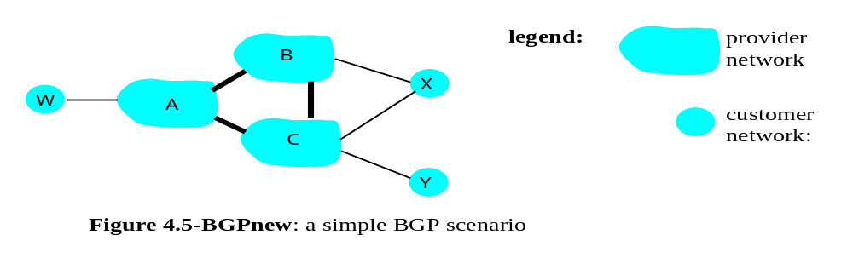
BGP
provider
networks
customer
networks
Routing policy:
Provider networks: A, B, C
Customer networks (of provider networks): X, Y, W
Notes:
A,B,C are provider networks
X,W,Y are customers (of provider networks)
X is dual-homed: attached to two networks
X does not want to route from B via X to C
.. so X will not advertise to B a route to C

Slide 51
BGP
provider
networks
customer
networks
Routing policy:
Provider networks: A, B, C
Customer networks (of provider networks): X, Y, W
X is dual-homed: attached to two networks
Notes:
A,B,C are provider networks
X,W,Y are customers (of provider networks)
X is dual-homed: attached to two networks
X does not want to route from B via X to C
.. so X will not advertise to B a route to C

Slide 52
BGP
X does not want to carry traffic from B to C,
so X will not advertise to B a route to C.
provider
networks
customer
networks
Routing policy:
Provider networks: A, B, C
Customer networks (of provider networks): X, Y, W
X is dual-homed: attached to two networks
Notes:
A,B,C are provider networks
X,W,Y are customers (of provider networks)
X is dual-homed: attached to two networks
X does not want to route from B via X to C
.. so X will not advertise to B a route to C

Slide 53
BGP
provider
networks
customer
networks
Routing policy:
A advertises to B the path AW
B advertises to X the path BAW
Notes:
A advertises to B the path AW
B advertises to X the path BAW
Should B advertise to C the path BAW?
No way! B gets no “revenue” for routing CBAW since neither W nor C are B’s customers
B wants to force C to route to w via A
B wants to route only to/from its customers!

Slide 54
BGP
provider
networks
customer
networks
Routing policy:
A advertises to B the path AW
B advertises to X the path BAW
Should B advertise to C the path BAW?
Notes:
A advertises to B the path AW
B advertises to X the path BAW
Should B advertise to C the path BAW?
No way! B gets no “revenue” for routing CBAW since neither W nor C are B’s customers
B wants to force C to route to w via A
B wants to route only to/from its customers!

Slide 55
BGP
No way!
B gets no revenue for routing CBAW as neither W nor C is B’s customer.
B wants to route only to/from its customers.
provider
networks
customer
networks
Routing policy:
A advertises to B the path AW
B advertises to X the path BAW
Should B advertise to C the path BAW?
Notes:
A advertises to B the path AW
B advertises to X the path BAW
Should B advertise to C the path BAW?
No way! B gets no “revenue” for routing CBAW since neither W nor C are B’s customers
B wants to force C to route to w via A
B wants to route only to/from its customers!

Slide 56
routing attacks
distance-vector
link-state
BGP

Slide 57
routing attacks
distance-vector:
announce 0 distance to all other nodes
link-state:
drop links; claim direct link to other routers
BGP:
announce arbitrary prefix; alter paths
Notes:
Distance Vector Routing
Announce 0 distance to all other nodes
Blackhole traffic
Eavesdrop
Link State Routing
Can drop links randomly
Can claim direct link to any other routers
A bit harder to attack than DV
BGP
ASes can announce arbitrary prefix
ASes can alter path

Slide 58



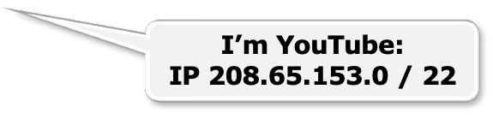



Prefix Hijacking: Case 1
“The Internet”
Pakistan
Telecom
YouTube
Telnor
Pakistan
Multinet
Pakistan
Aga Khan
University
examples from https://people.cs.umass.edu/~phillipa/CSE390/RoutingSecurity.pptx
Notes:
-level of autonomous systems
-e.g., YouTube, AT&T, pakistan telecom
-routing is done on IP addresses, so when someone wants to go to YouTube they get YouTube’s IP address and YouTube announces to the world that they have the ip address and traffic is forwarded towards them. So here multinet would route to it’s provider pakistan telecom that then forwards the traffic on to youtube.
-these networks chosen for a specific reason which is that there was an incident in february 2008 pakistan telecom actually hijacked traffic going to youtube (misconfiguration).
-they announced to the world that they’re youtube and traffic destined to youtube was routed to them
-youtube was unavailable for a couple of hours as operators phone each other to figure out what was going on.

Slide 59
  Here’s what should have happened….
Hijack + drop packets going to YouTube
“The Internet”
X
Pakistan
Telecom
YouTube
Telnor
Pakistan
Multinet
Pakistan
Aga Khan
University
  Block your own customers.

Slide 60
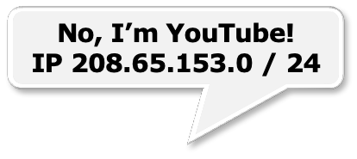



  But here’s what Pakistan ended up doing…
“The Internet”
Pakistan
Telecom
YouTube
Pakistan
Telecom
Telnor
Pakistan
Multinet
Pakistan
Aga Khan
University
Notes:
Our works focuses on attacks of this flavor..

Slide 61






Prefix Hijacking: Case 2
Level3, VZW, 22394 66.174.161.0/24
VZW, 22394 66.174.161.0/24
22394 66.174.161.0/24
Paths chosen based on cost and length.
Notes:
B4 we start with attacks lets lookat how bgp works
We have this prefix
22.. Ann, verizon routes traffic to it, reannounces it
“ (level 3)
Some of you may remember a recent “interesting incident” that actually made it into the nytimes
Ctel ann prefix; this wrong, b\c it’s not suppose to originate
Lots of isps fell for this, we look at the data and there we a number of large isp, including thisone that remains nameless,that fell for this.
In fact we found that this happened for 50K prefix, including the DoD.
Also, even worse, renesys found that theres an interception
C tel is so big…
There have been many well publicized misconfigurations that illustrate the insecurity of BGP. For example consider the prefix on the last slide. In april 2010 China telecom announced a direct path to this prefix (as well as 50k other ones). So now ISP 1 has two paths to the prefix and needs to pick 1. Since the china telecom path is shorter ISP 1 will choose to route through it. And what’s interesting here, is that since China Telecom is so large they actually had a router in their network that still new the correct path to the prefix so the traffic went back out to level 3 and on to verizon.

Slide 62
  April 2010 : China Telecom intercepts traffic
ChinaTel path is shorter
?
ChinaTel 66.174.161.0/24
Level3, VZW, 22394 66.174.161.0/24
  This prefix and 50K others were announced by China Telecom
  Traffic for some prefixes was possibly intercepted
Notes:
B4 we start with attacks lets lookat how bgp works
We have this prefix
22.. Ann, verizon routes traffic to it, reannounces it
“ (level 3)
Some of you may remember a recent “interesting incident” that actually made it into the nytimes
Ctel ann prefix; this wrong, b\c it’s not suppose to originate
Lots of isps fell for this, we look at the data and there we a number of large isp, including thisone that remains nameless,that fell for this.
In fact we found that this happened for 50K prefix, including the DoD.
Also, even worse, renesys found that theres an interception
C tel is so big…
There have been many well publicized misconfigurations that illustrate the insecurity of BGP. For example consider the prefix on the last slide. In april 2010 China telecom announced a direct path to this prefix (as well as 50k other ones). So now ISP 1 has two paths to the prefix and needs to pick 1. Since the china telecom path is shorter ISP 1 will choose to route through it. And what’s interesting here, is that since China Telecom is so large they actually had a router in their network that still new the correct path to the prefix so the traffic went back out to level 3 and on to verizon.

Slide 63

Path Tampering
Remove ASes from the AS path
Add ASes to the AS path
701 3715 88
701
3715
88
?
701
701 88 →
701 3715 88
88

Slide 64
how to secure routing?

Slide 65



RPKI
Resource Public Key Infrastructure
certified mapping
from ASes to public keys and IP prefixes
X
RPKI: Invalid!
?
ChinaTel 66.174.161.0/24
Level3, VZW, 22394 66.174.161.0/24
  RPKI shows China Telecom is not a valid origin for this prefix.
Notes:
One way we might solve this is using the cryptgraphy
One way to solve this is to do origin authentication using RPKI which is a certified mapping between IP prefixes and the Ases that own them. So now ISP 1 can check the RPKI and see that china telecom is not a valid originator of this prefix and choose the correct path to the prefix.

Slide 66





RPKI
insufficient!
?
ChinaTel, 22394 66.174.161.0/24
Level3, VZW, 22394 66.174.161.0/24
  Malicious router can pretend to connect to the valid origin.
Notes:
However, if instead of just being misconfigured, china telecom decided to behave maliciously, RPKI would not be enough. So for example china telecom could pretend they have a direct connection to the AS that owns the prefix by announcing China telecom 22394.

Slide 67
S-BGP
Each AS on the path cryptographically signs its announcement
Guarantees that each AS on the path made the announcement in the path:
AS path indicates the order ASes were traversed;
No intermediate ASes were added or removed;
Notes:
S-BGP: Secure BGP
Each AS on the path cryptographically signs its announcement
Guarantees that each AS on the path made the announcement in the path.
Address attestations
Claim the right to originate a prefix
Signed and distributed out-of-band
Checked through delegation chain from ICANN
Route attestations
Distributed as an attribute in BGP update message
Signed by each AS as route traverses the network
Signature signs previously attached signatures
S-BGP can validate
AS path indicates the order ASes were traversed
No intermediate ASes were added or removed

Slide 68
S-BGP
Deployment challenges:
Complete, accurate registries
Public key infrastructure
Cryptographic operations
Need to perform operations quickly
Difficulty of incremental deployment
Notes:
Complete, accurate registries
E.g., of prefix ownership
Public Key Infrastructure
To know the public key for any given AS
Cryptographic operations
E.g., digital signatures on BGP messages
Need to perform operations quickly
To avoid delaying response to routing changes
Difficulty of incremental deployment
Hard to have a “flag day” to deploy S-BGP

Slide 69
?

Slide 70
Readings
BGP Hijack Explained by Jorge Ribas
Why Is It Taking So Long to Secure Internet Routing? by Sharon Goldberg

Slide 71
Thank You
be on the road
Notes:
Run your own race.

